Slide 1
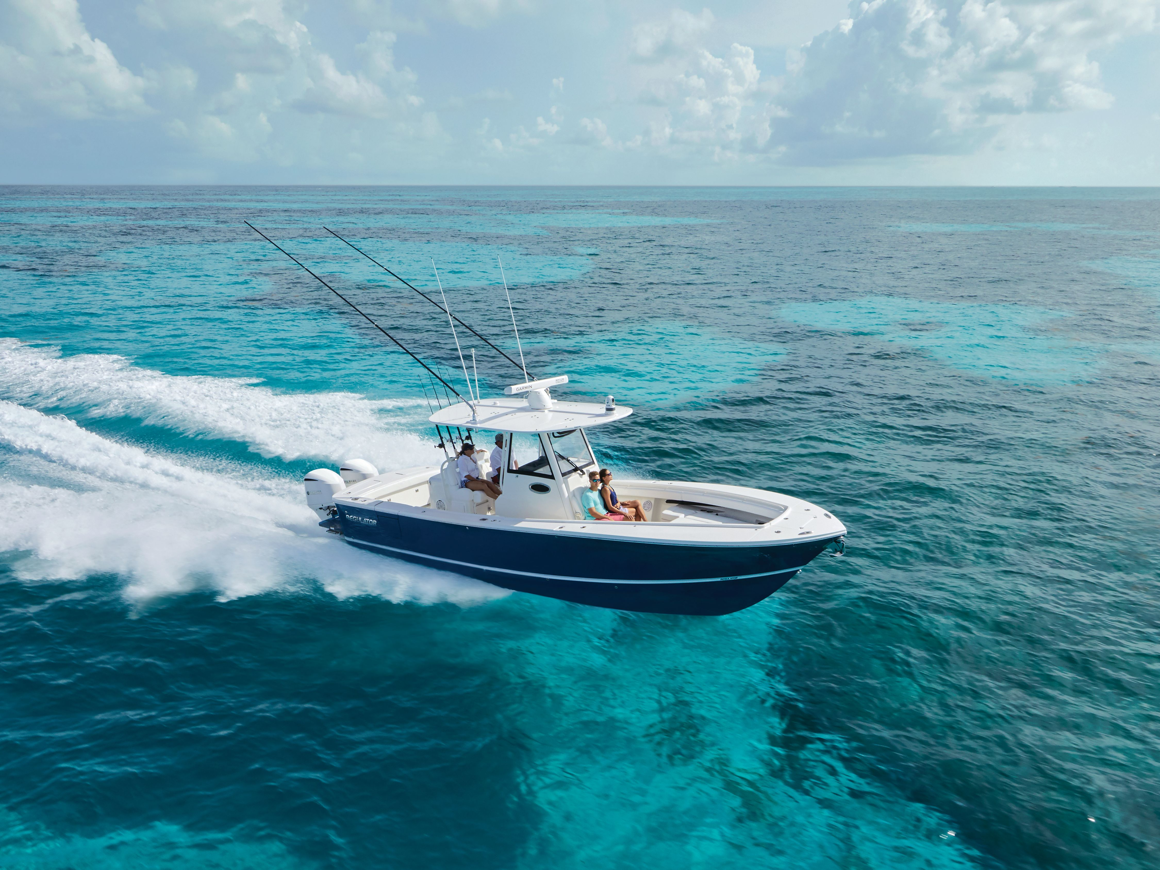
2025 Model Year webinar to start shortly

Slide 2
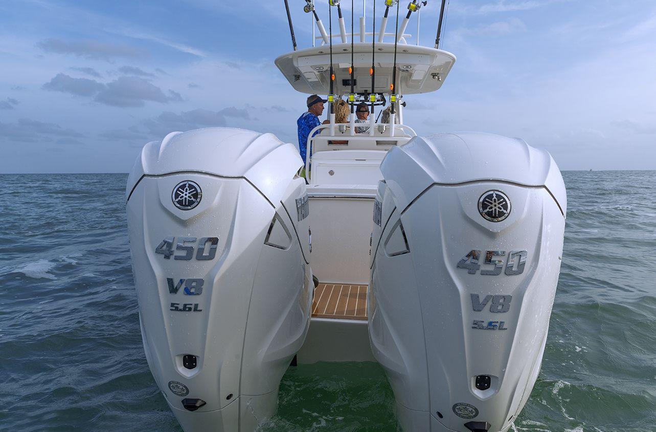
AGENDA
Marketing updates- Keith Ammons
Some model year changes- David Clubbs
Pricing updates- Keith Ammons

Slide 3
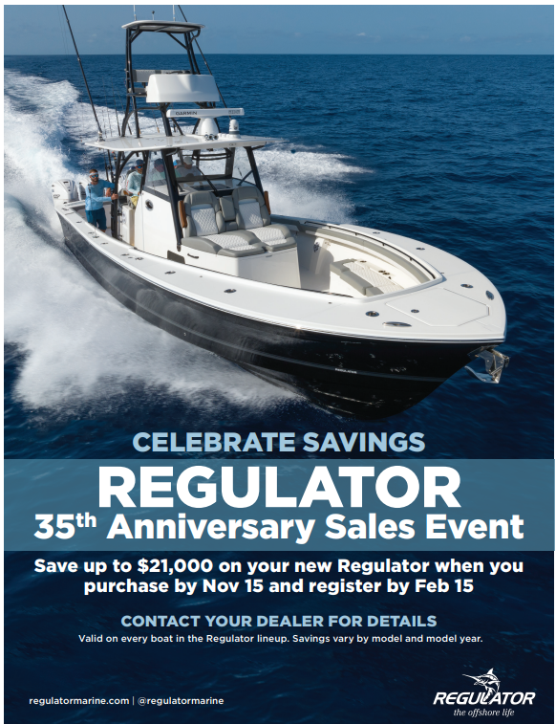
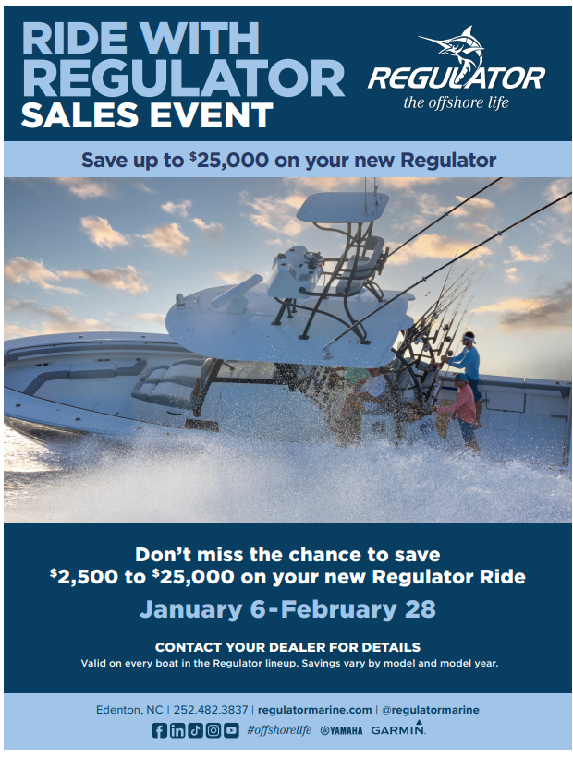

Retail and Wholesale programs

Slide 4
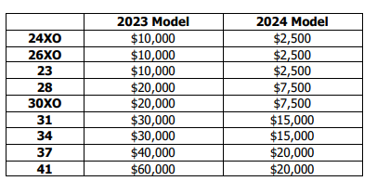
Retail and Wholesale programs
$2,500 SPIFF for all YMBS registered boats this week.

Slide 5
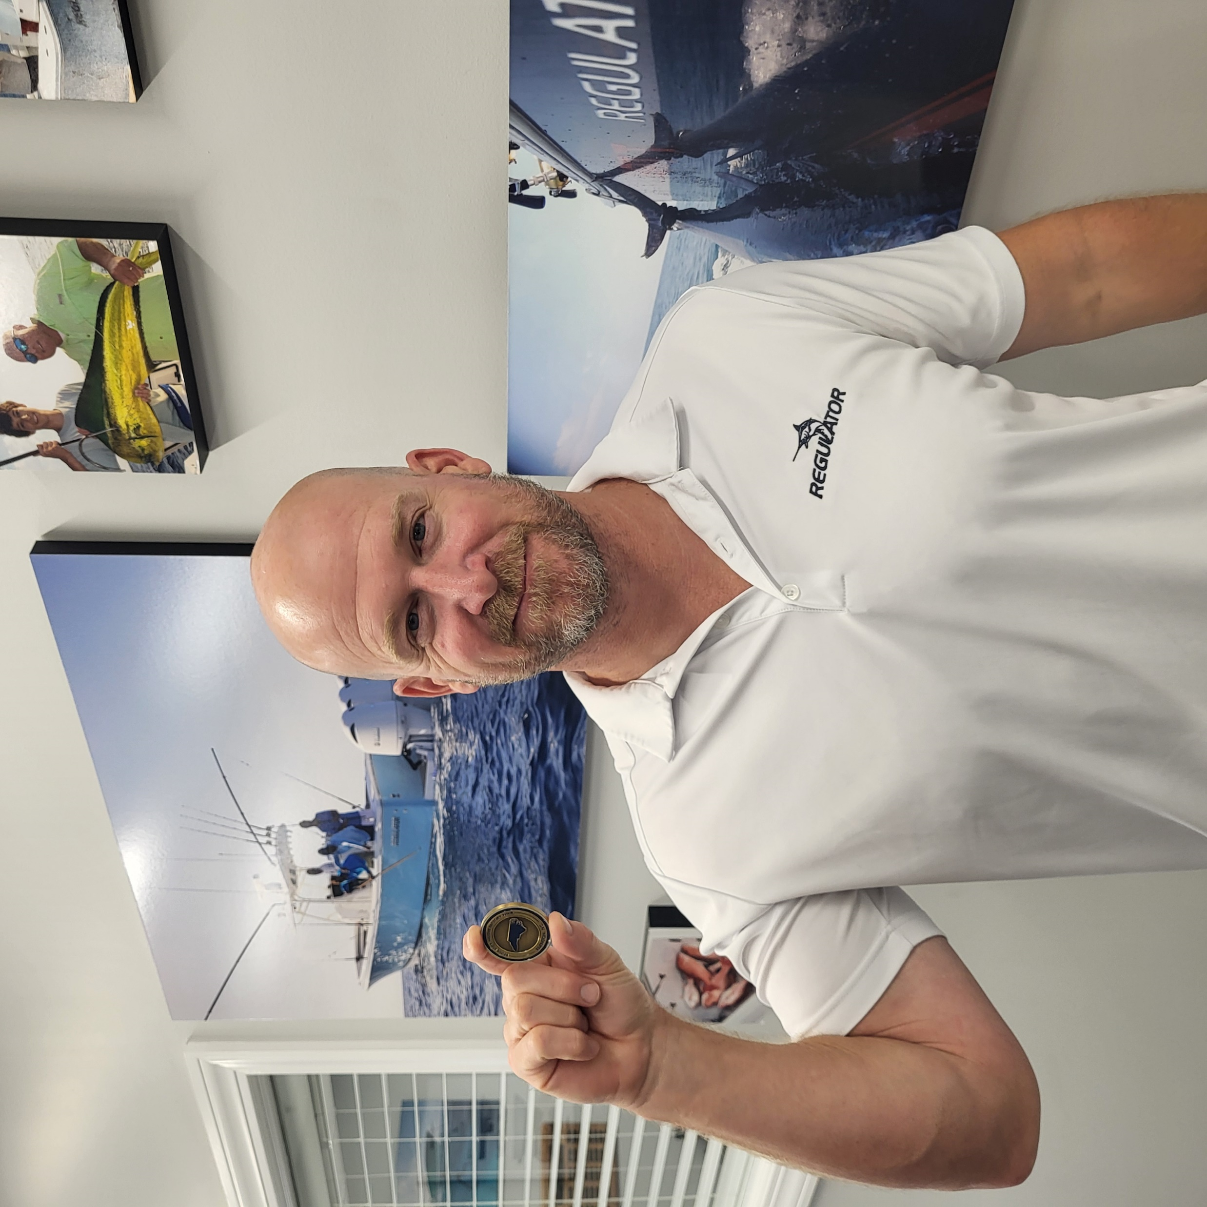
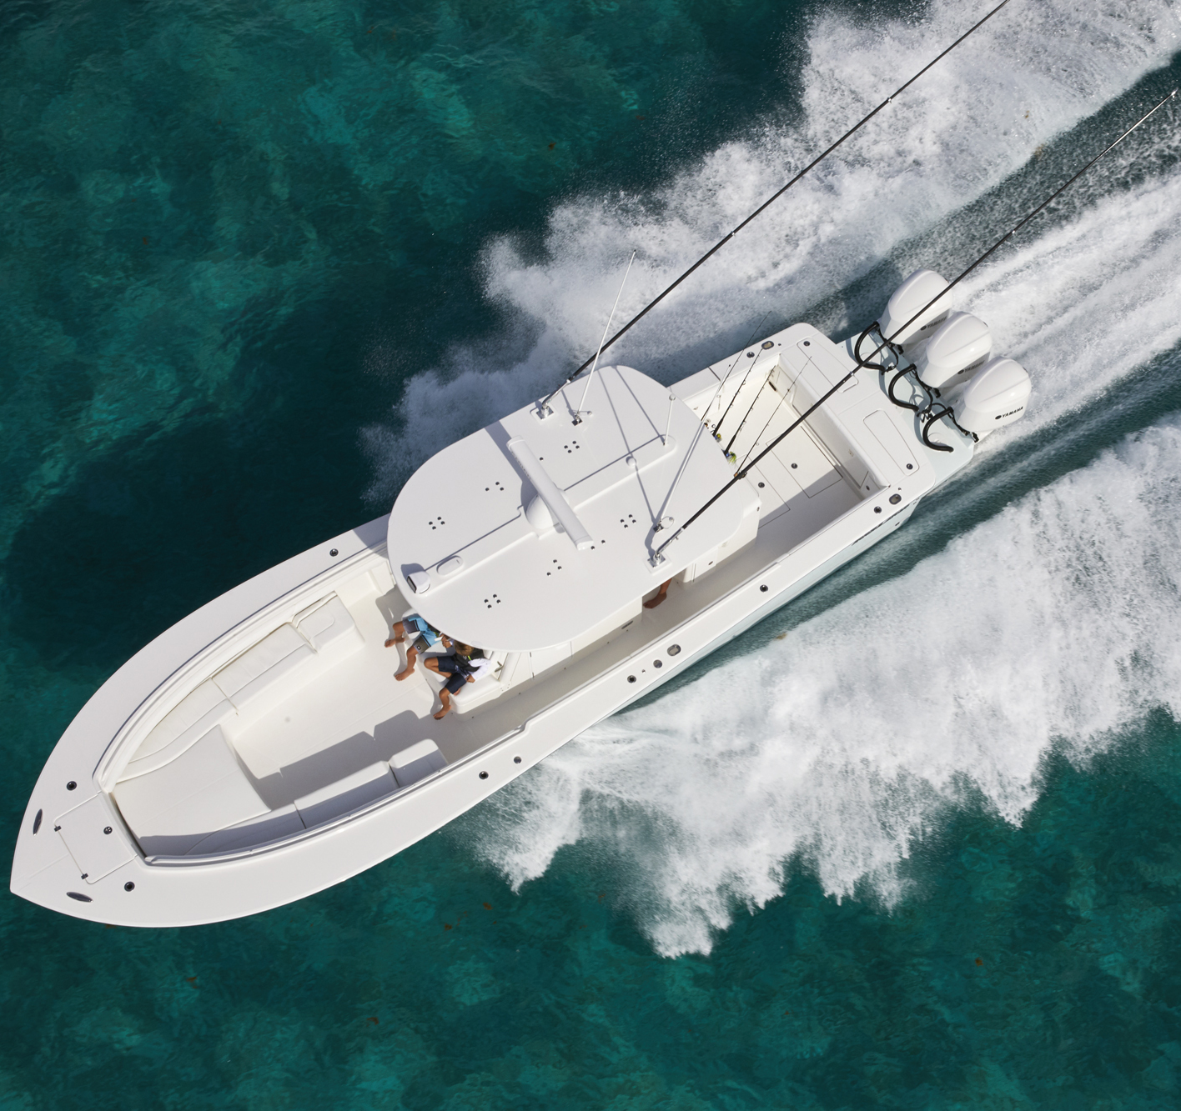
Your sales team is here to help
Keith Ammons cell 251-422-4162
Tim Ford cell 203 260-6381
Alex leva cell 813-240-3246
Michael Diggle cell 631-707-4846
Drew Halford cell 843-810-9253
First person to text each of us gets $100 in Regulator gear. Text must be a selfie of you and a Regulator challenge coin. 5 winners. Ready go….

Slide 6


Slide 7
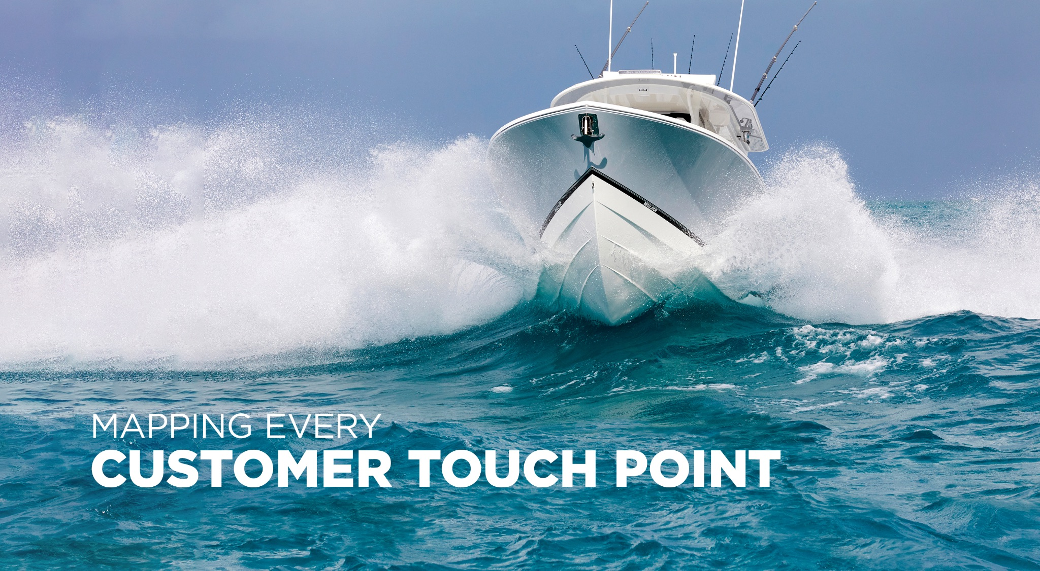

Slide 8
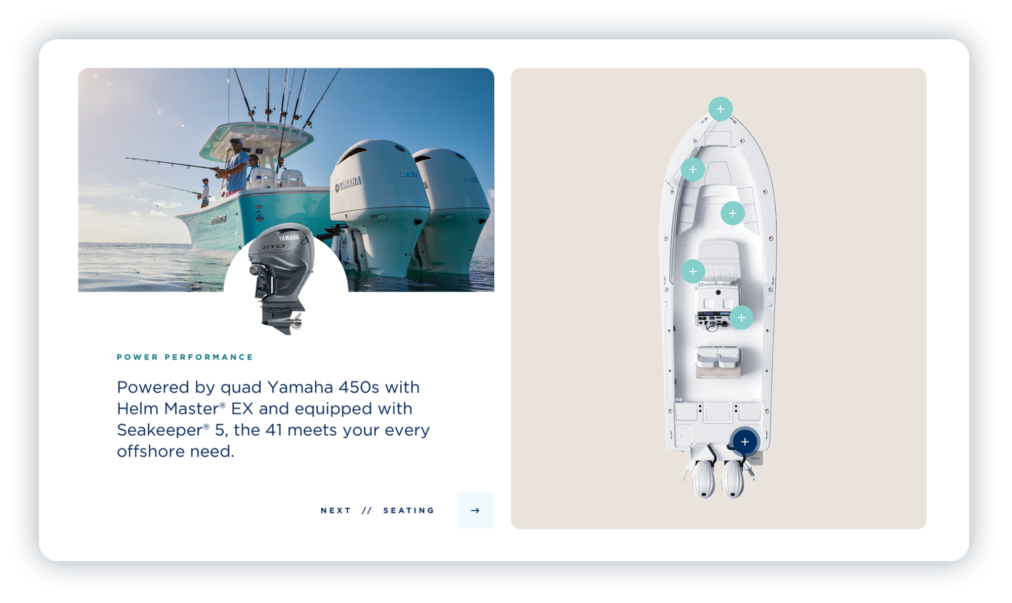
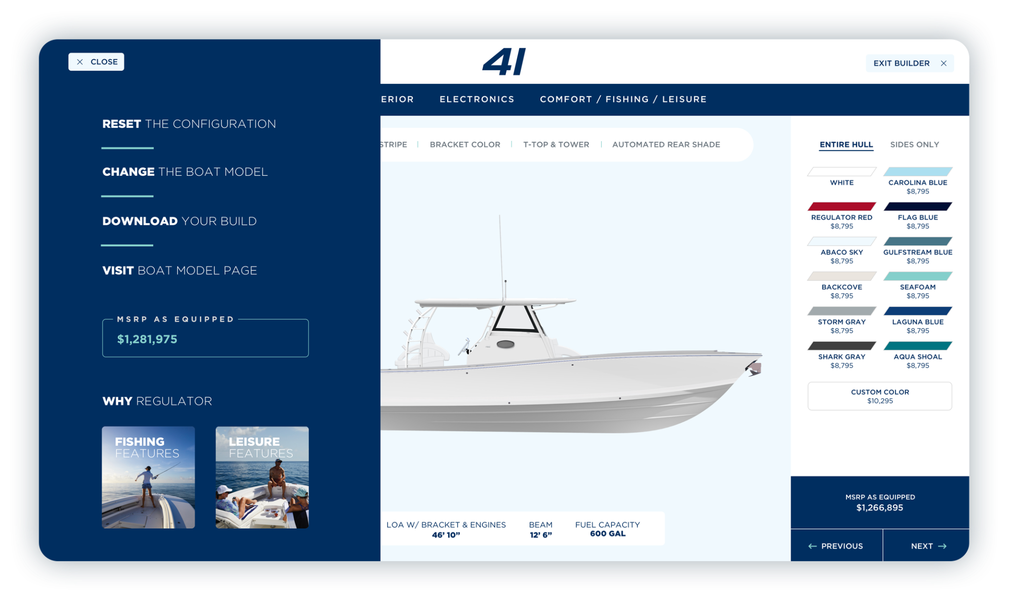
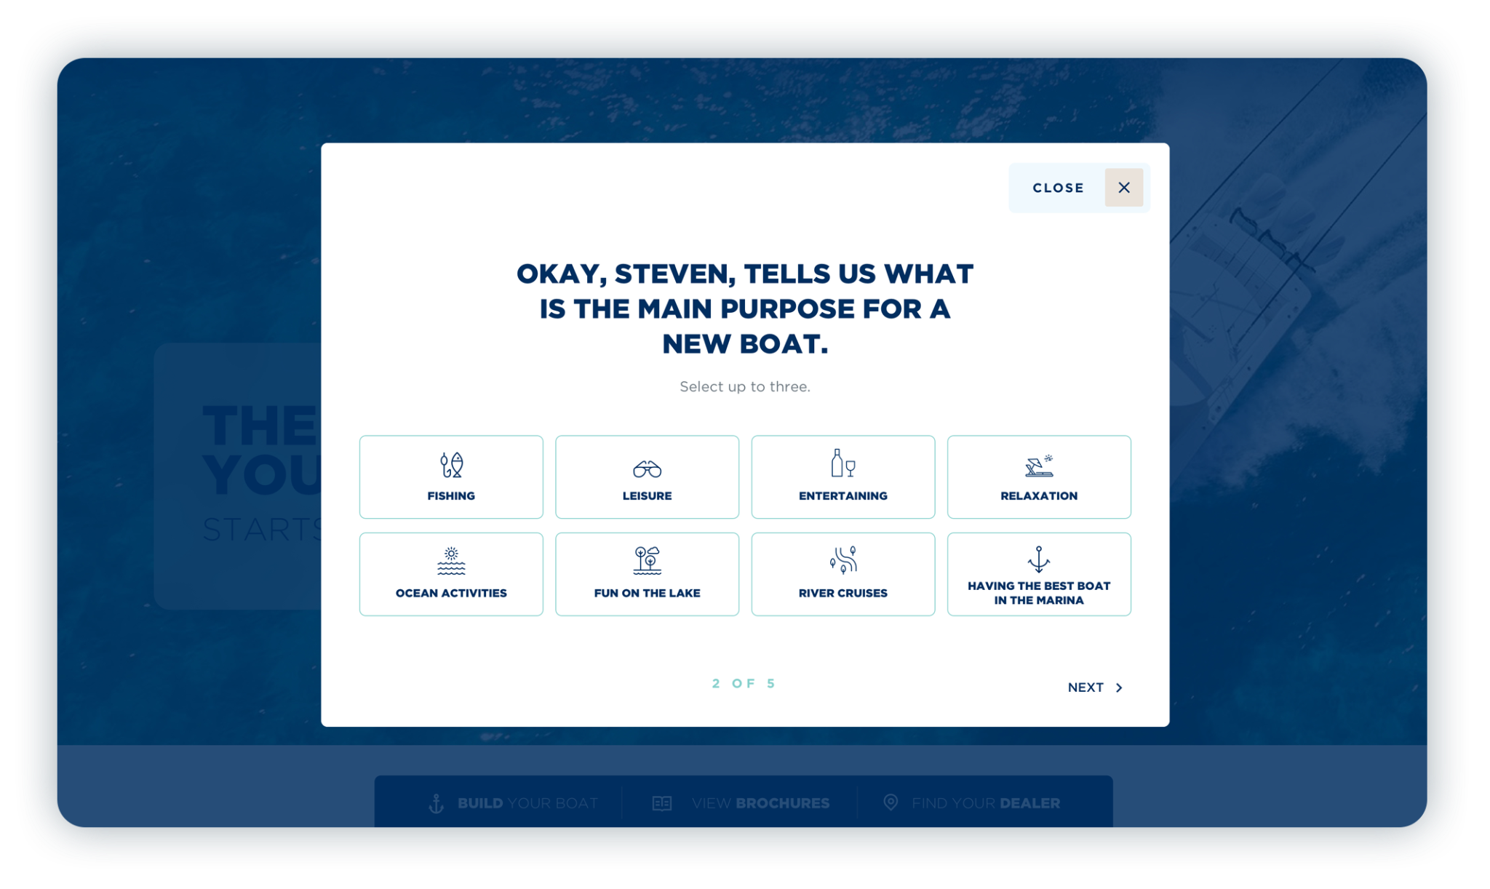
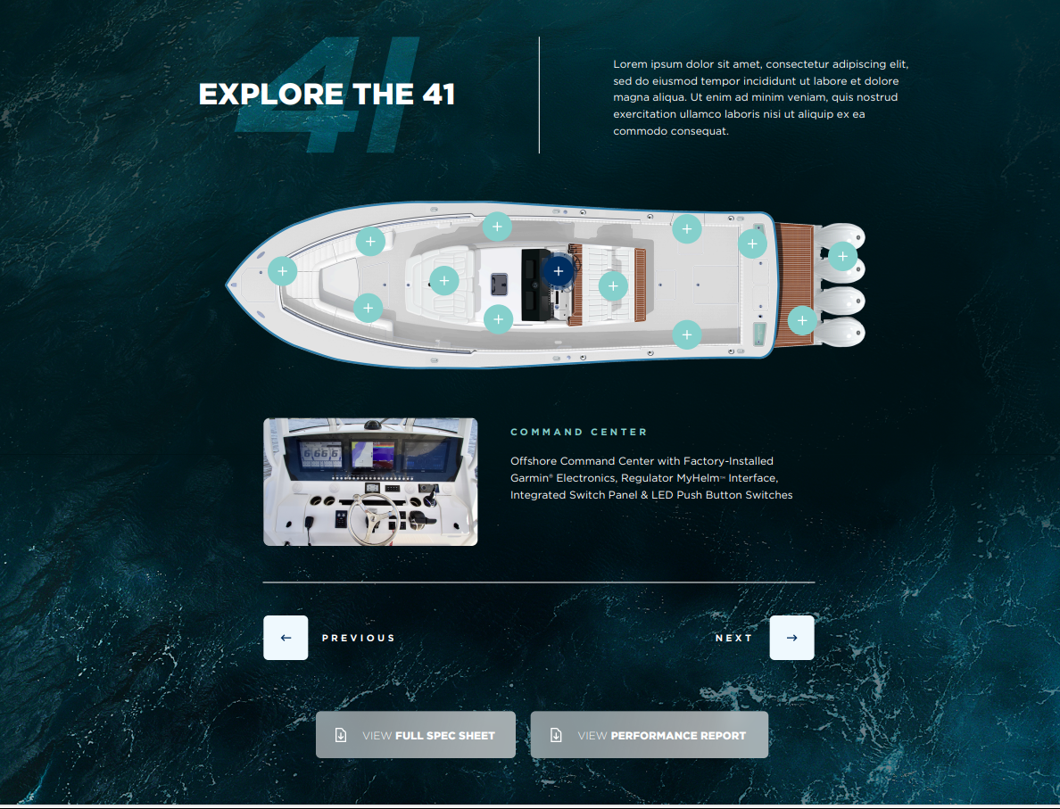

Slide 9
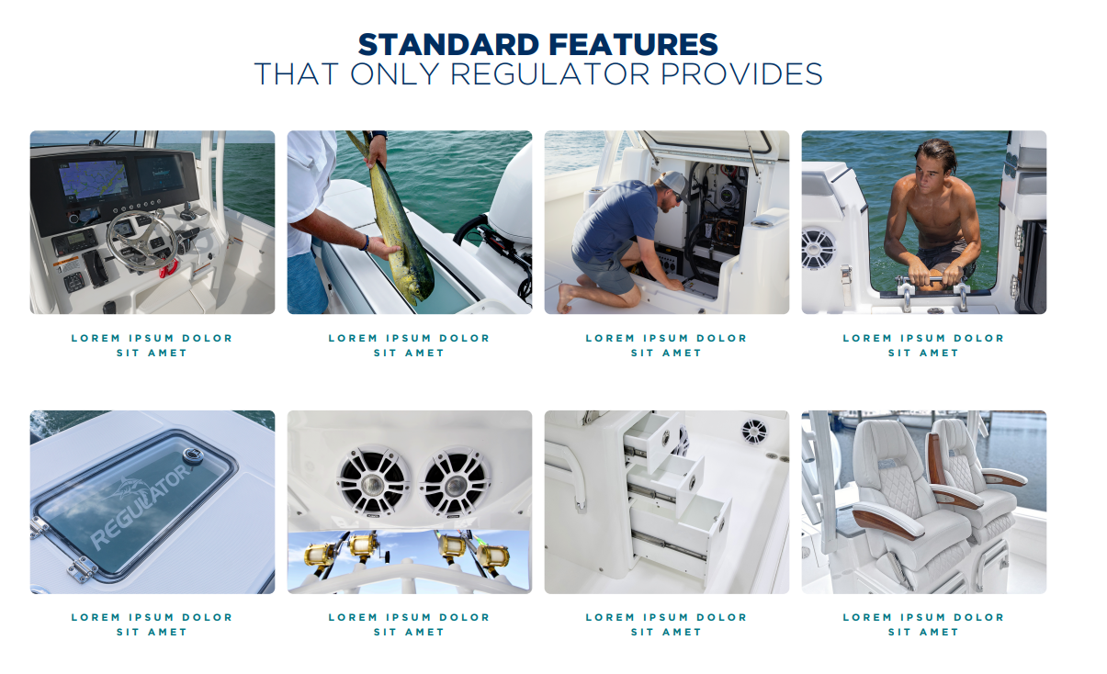
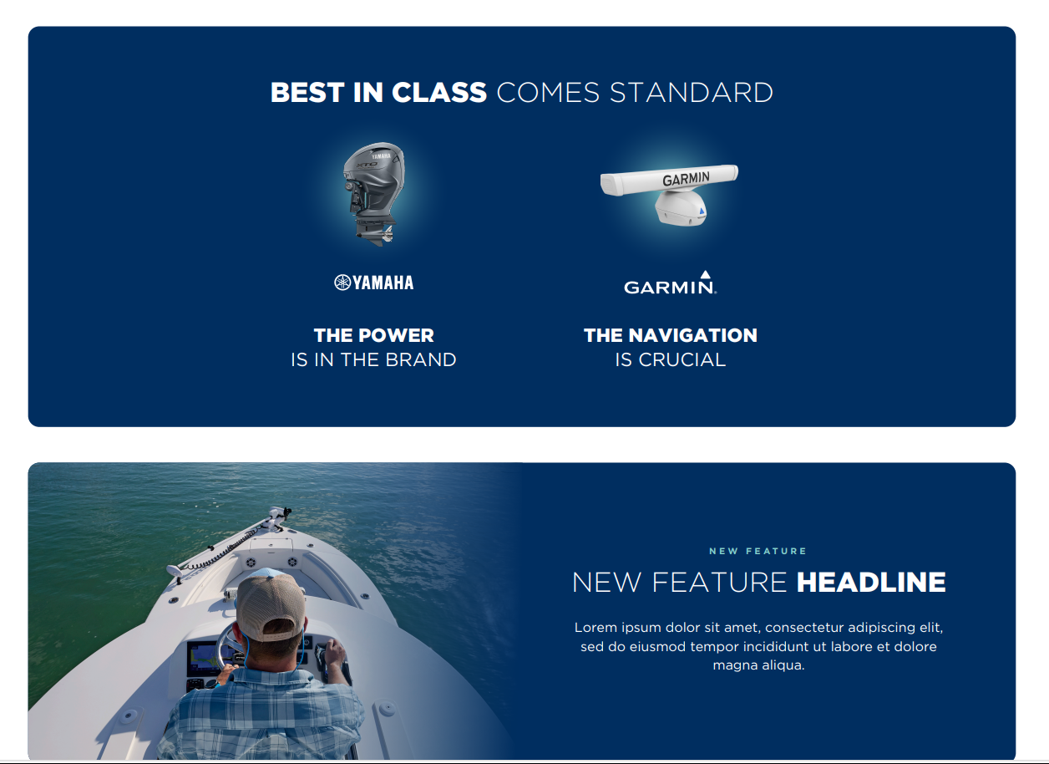
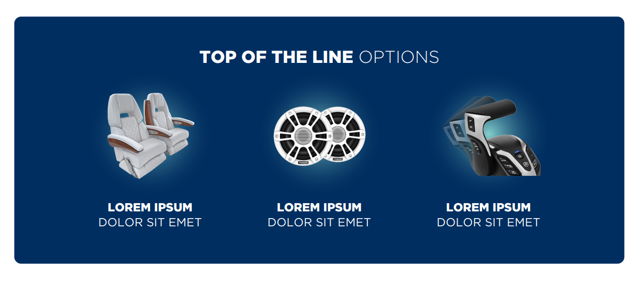
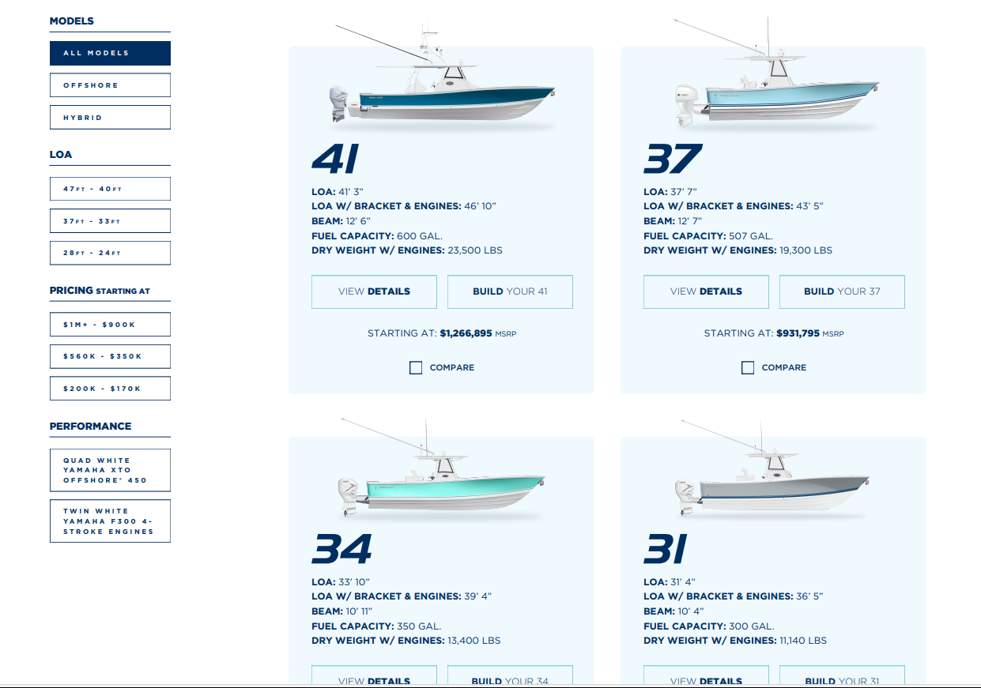

Slide 10
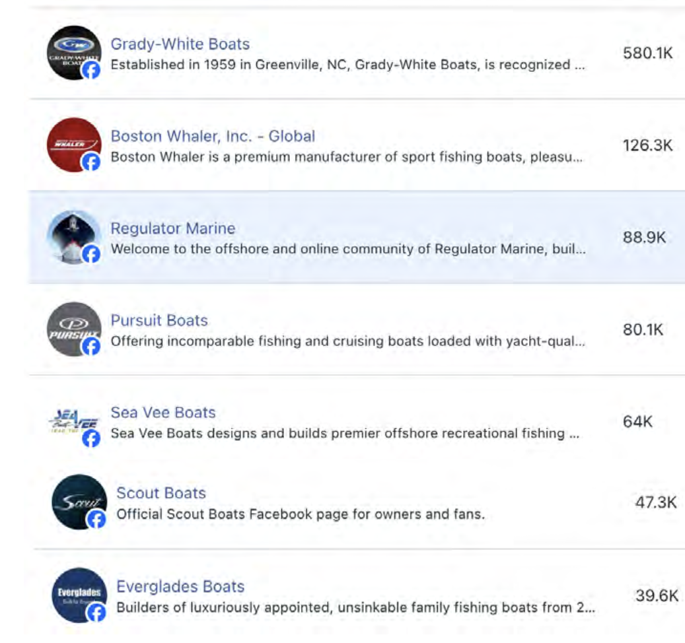
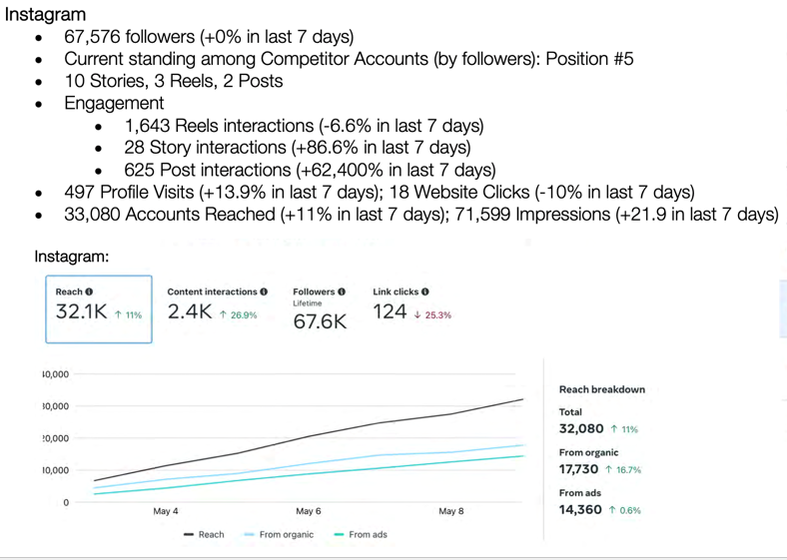
Social
Number 3 on Face Book in CC premium brands
95,000 followers
Reaching over 200K people each week
Getting over 3K clicks a week
Number 5 in Instagram in CC premium brands
67,000 followers
Reaching over 32K people each week
Getting over 2K content interactions a week

Slide 11

David Clubbs
VP of Engineering
Model year 2025

Slide 12
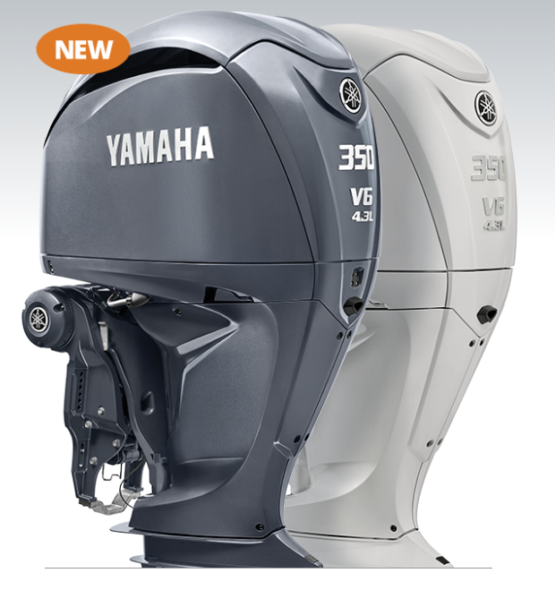
Yamaha F350
Standard on 24x0, 30xo, 34cc
INTERNAL DATA – OFFICIAL BULLETINS IN PROCESS

Slide 13
Yamaha F350
Standard on 24x0, 30xo, 34cc
INTERNAL DATA –
24xo F300 50.0 /F350 56mph

Slide 16
Yamaha F350
Standard on 24x0, 30xo, 34cc
INTERNAL DATA – FULL THROTTLE
24xo F300 50.0 / F350 56mph

Slide 17
Yamaha F350
Standard on 24x0, 30xo, 34cc
INTERNAL DATA – FULL THROTTLE
24xo F300 50.0 / F350 56mph
30xo F300 56.6 / F350 62.7 mph

Slide 20
Yamaha F350
Standard on 24x0, 30xo, 34cc
INTERNAL DATA – FULL THROTTLE
24xo F300 50.0 / F350 56mph
30xo F300 56.6 / F350 62.7 mph
34cc F300 61 / F350 64.5 mph

Slide 23
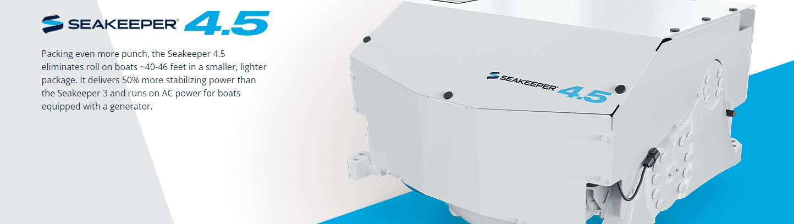
37 – 41 Gyro Change

Slide 24
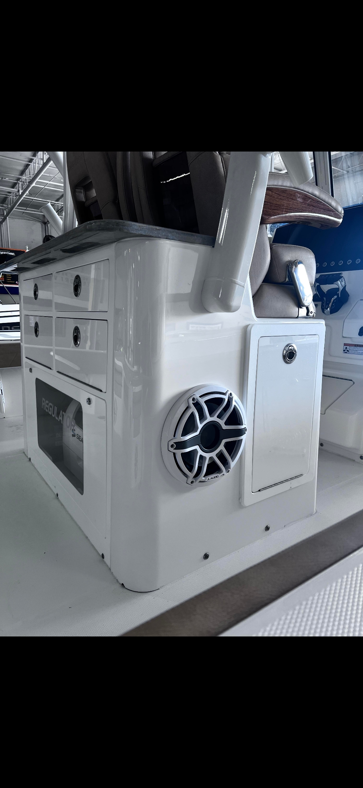
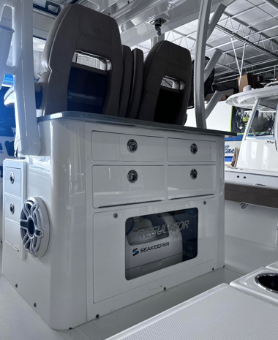
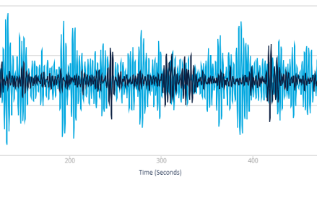
30xo SeaKeeper Option
Testing performed with optional tower
Tackle Center Cabinet Revisions w/ Option
cutting board stows just under lazz hatch
Abbreviated side cabinets
No frame required
Weighs 365 pounds + batteries = 485 pounds
Low power consumption ~ 35 amps
Realized 75% role reduction
Installed Specifications

Slide 25
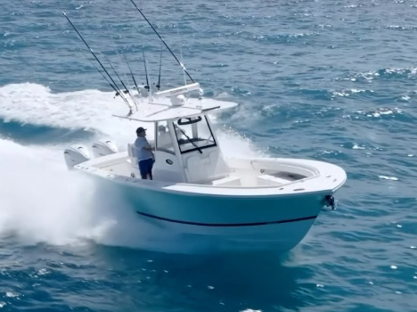
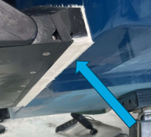
SEAKEEPER RIDE Active Control
Standard on 28, 31, and 34
Optional on 24xo, 26xo, and 30xo
Partnered with SeaKeeper for rigorous factory testing
28 – 525mm system. Bow quartering performance results
  36.1% roll reduction
  23.5% pitch reduction
  10% reduction in accelerations

Slide 26
SEAKEEPER RIDE Active Control
30xo 525mm system. Bow quartering performance results
  39.4% roll reduction
  44.2% pitch reduction
  19.6% reduction in accelerations
31 600mm system. Bow quartering performance results
  30% roll reduction
  62% pitch reduction

Slide 27
SEAKEEPER RIDE Active Control
34 600mm system. Bow quartering performance results
  42.9% roll reduction
  18.8% pitch reduction
  8.7% reduction in accelerations

Slide 28
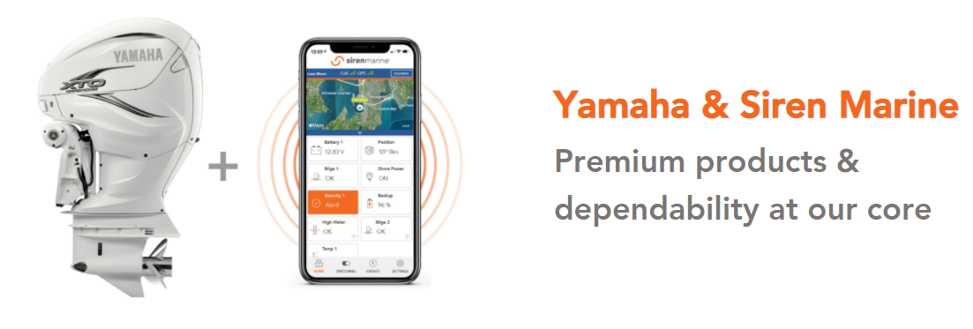
Siren Remote Monitoring
Standard on 31 and up
Battery monitoring
Bilge monitoring
Console door monitoring
Expandable system
Standard on 34 and up
High water alarm monitoring
Shore power connection monitoring
Subscription required

Slide 29
GARMIN 9000 series MFD
  8617 displays will be replaced by the new 9000 series displays
  9000 series benefits:
    Integrated 4K for an industry first in clarity
    7 times faster processing speeds makes this unit ideal for MyHelm functionality
    Bluenet network for 10X network speed
  37 and 41 triple helms will upgrade to three 9019’s
  37 standard will be dual 9022’s

Slide 30
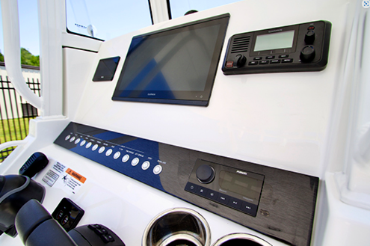
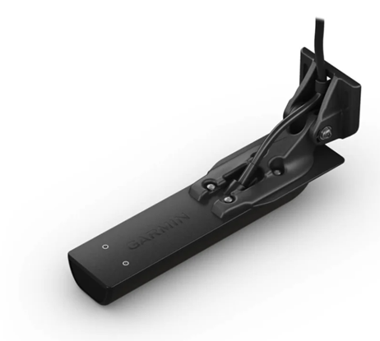
GARMIN
1643xsv to replace 8616 on the 23 and 26xo
  Dual screen upgrade still available on the 26xo
Garmin transducer
  GT12M thruhull transducer will replace the Airmar B150
  Allows for adding the GT36 side scan sonar to boats with single screens
    23, 24xo, 26xo

Slide 31
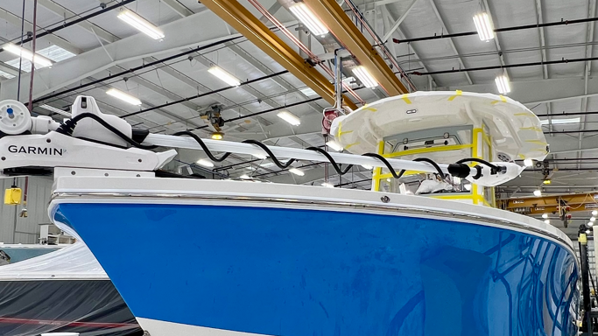
GARMIN - Kraken
All trolling motor options are moving to the Garmin Kraken with full MFD interface
  24xo and 26xo receive the 75” Kraken
  30xo receives the 90” Kraken
Kraken Benefits
  100 pounds of thrust
  Wirelessly connects to Garmin screens
  Floating remote
  Waypoint and mapping directly from the MFD similar to autopilot functionality
Does not power deploy or retract

Slide 32
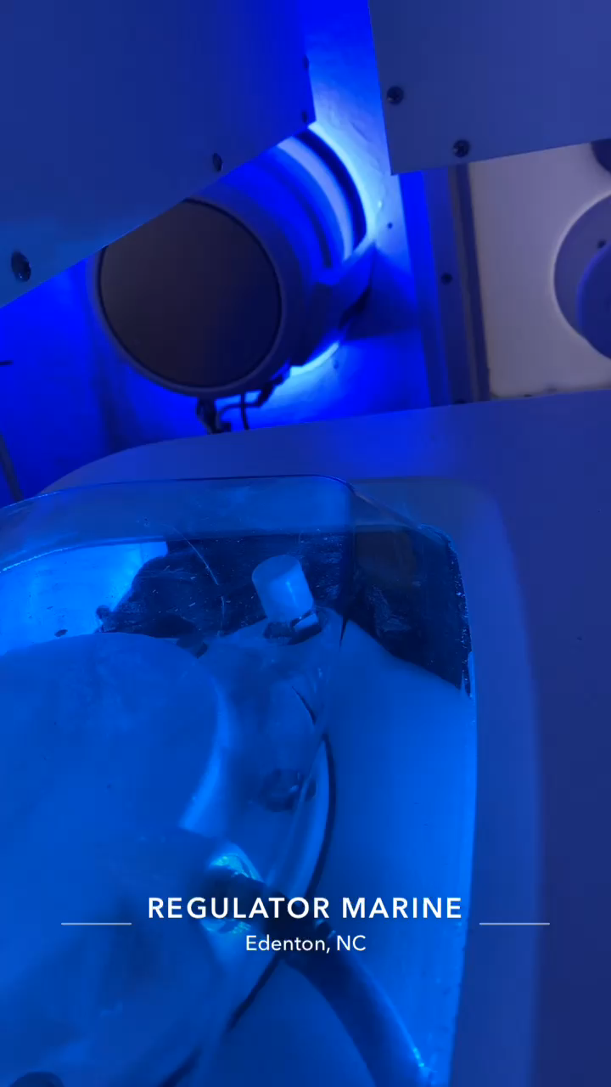
GARMIN - JL
JL speakers and subs will replace Fusion
Retains Fusion head units and amplifiers
Full Garmin aftermarket support and warranty

Slide 33
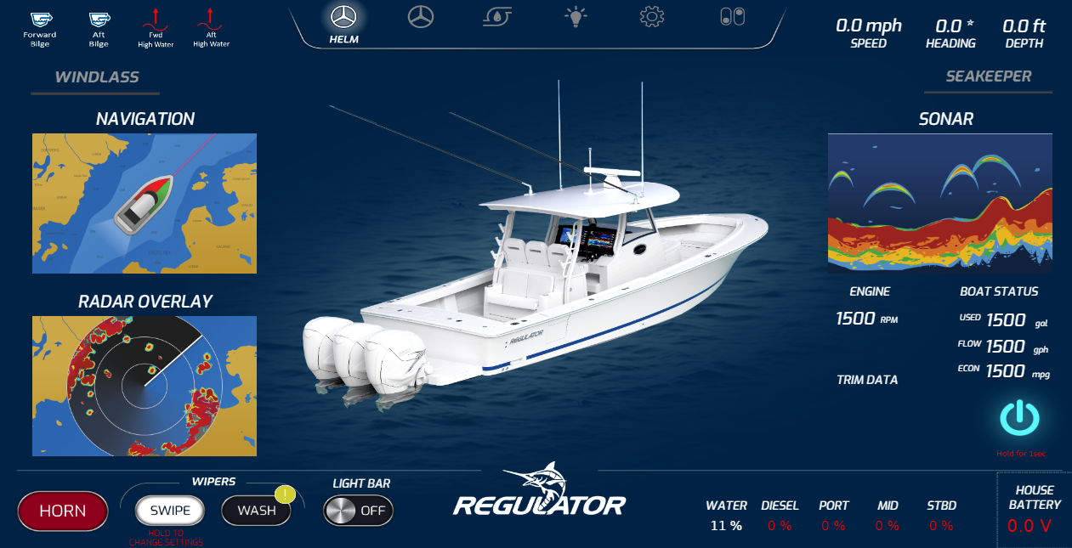
MyHelm
Garmin 9000’s allow for more integration and seamless intuitive boat control
One tap to charts, radar, sonar, and engine data,
Embedded nav chart on new Coning page

Slide 34
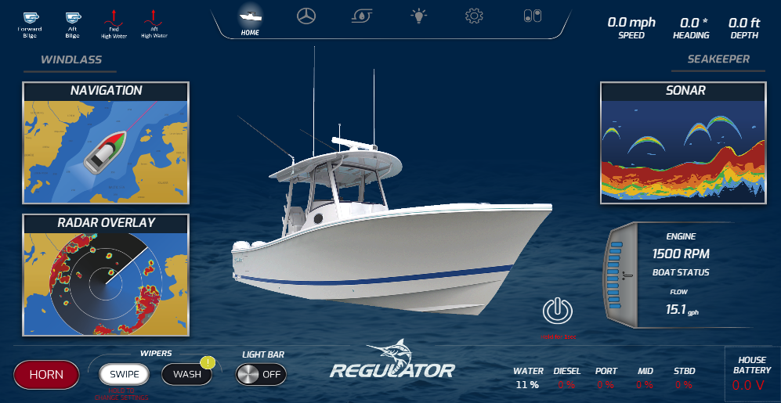

Slide 35
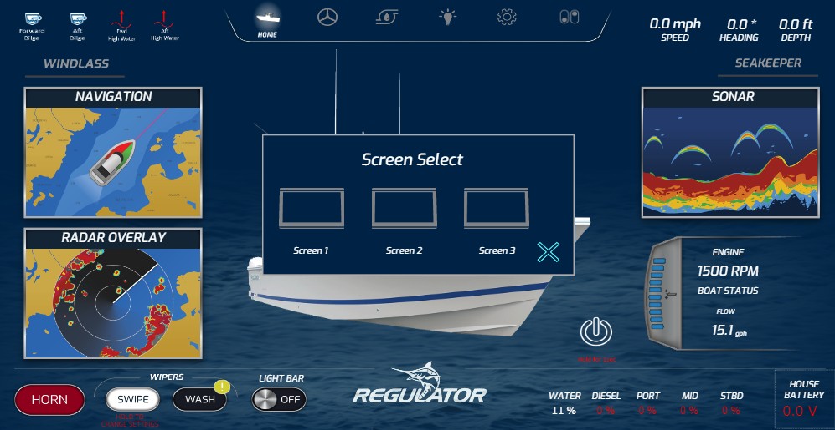

Slide 36
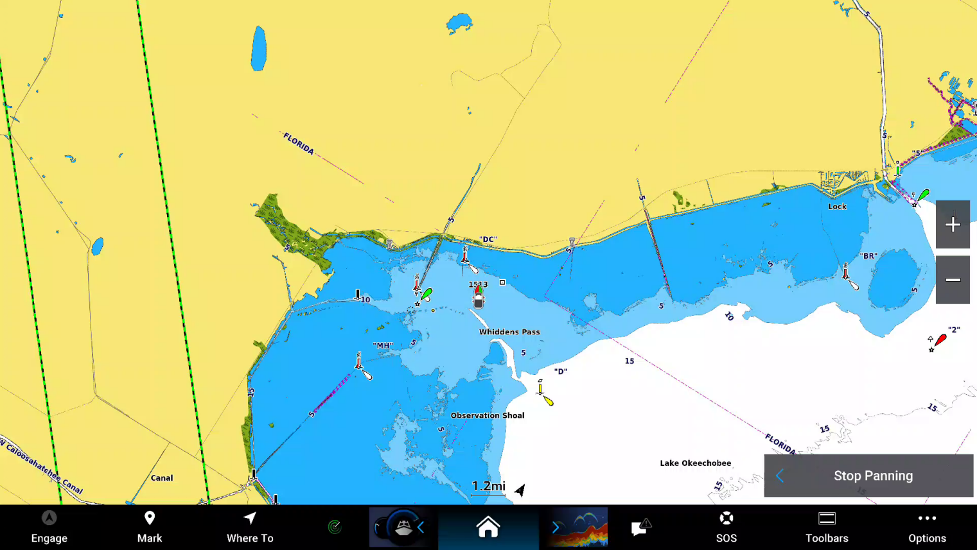

Slide 38
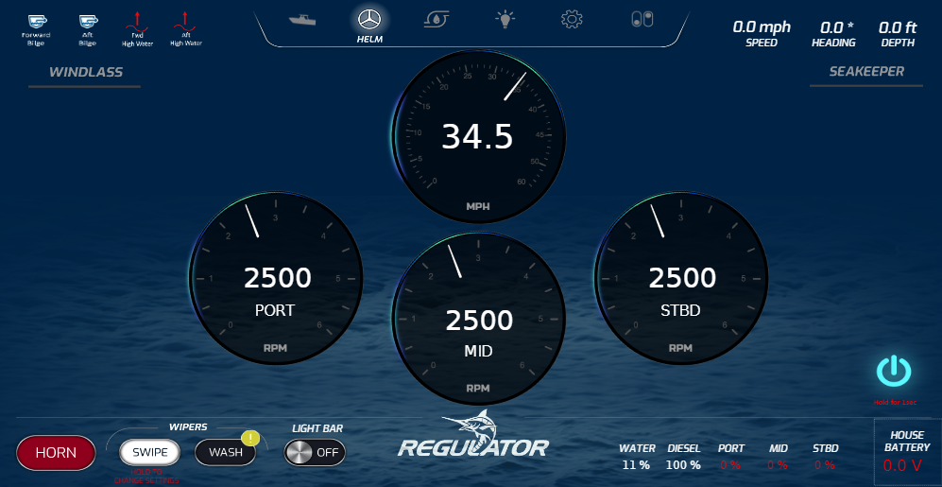

Slide 39
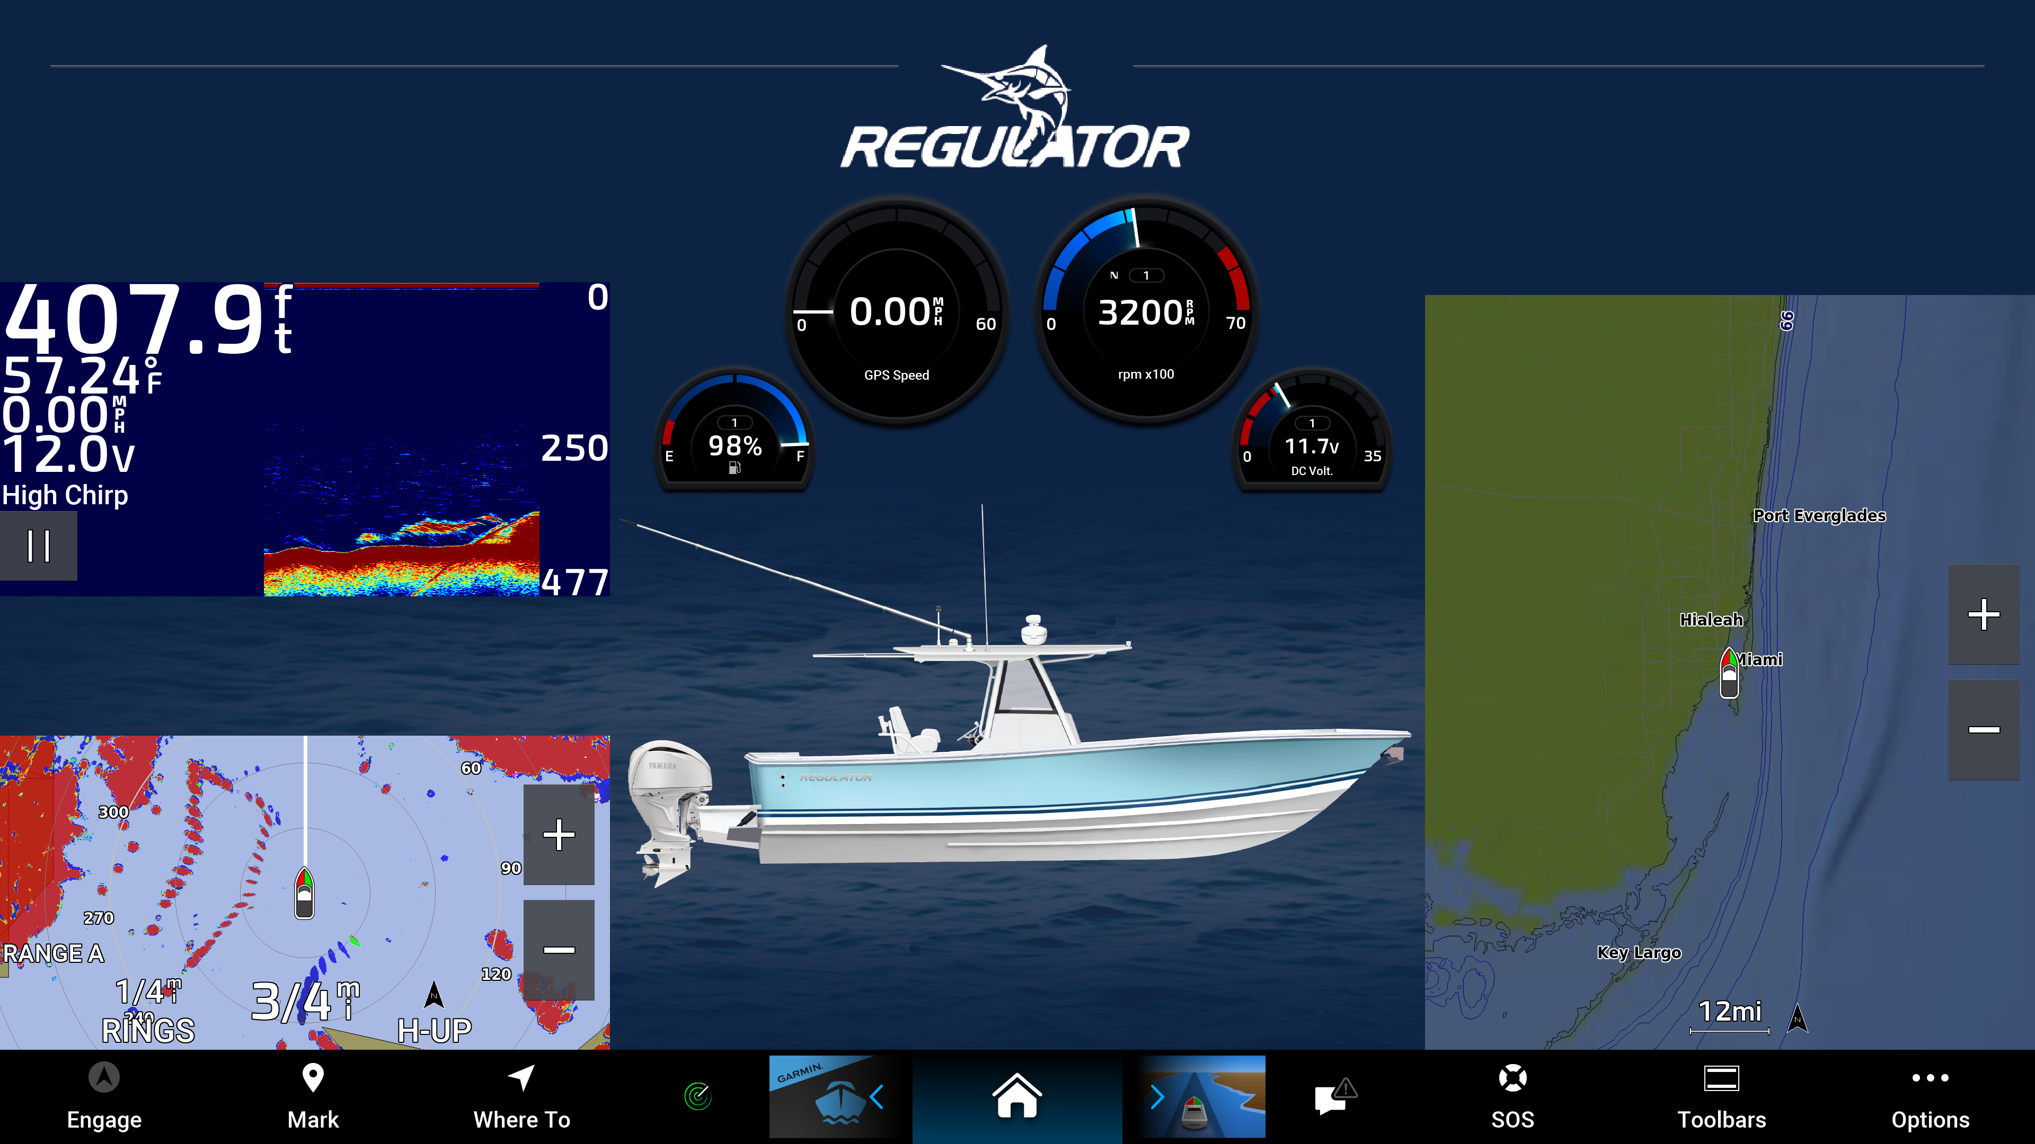

Slide 41
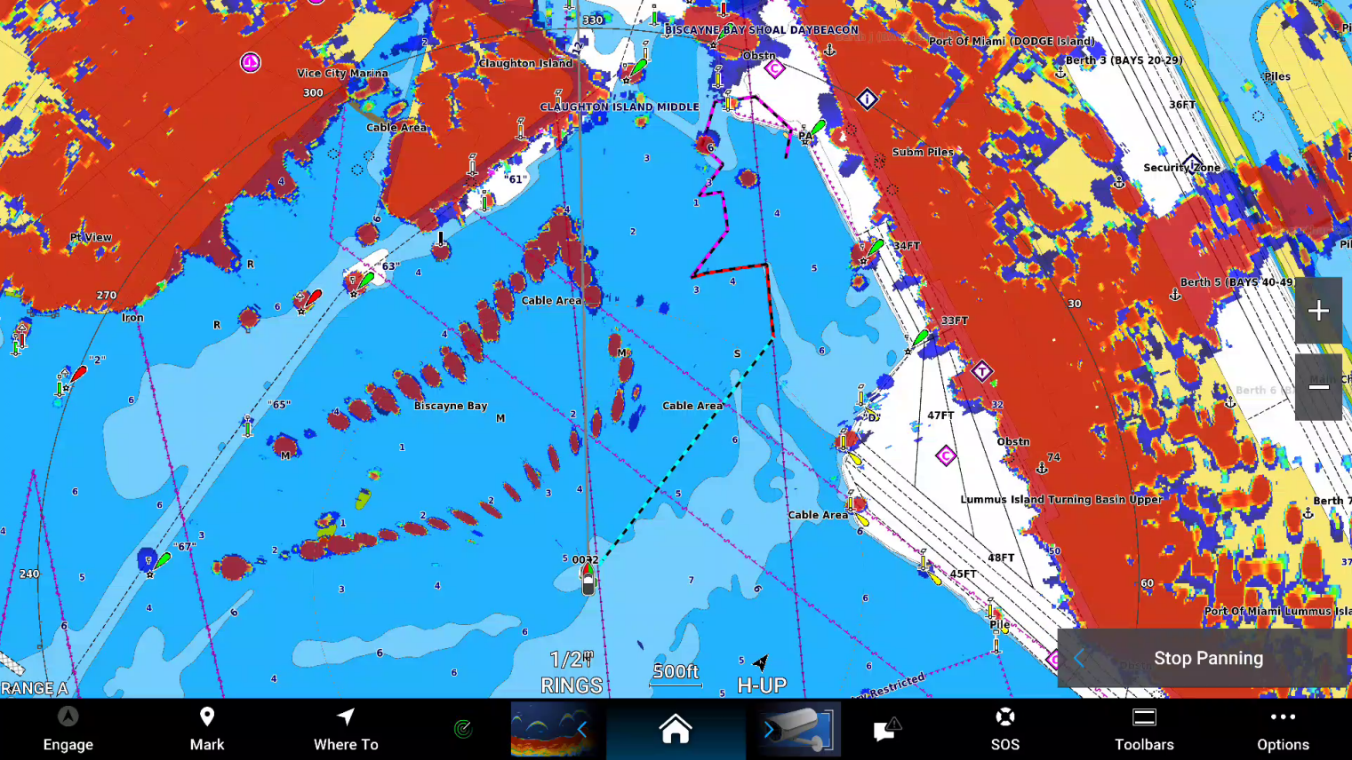

Slide 45
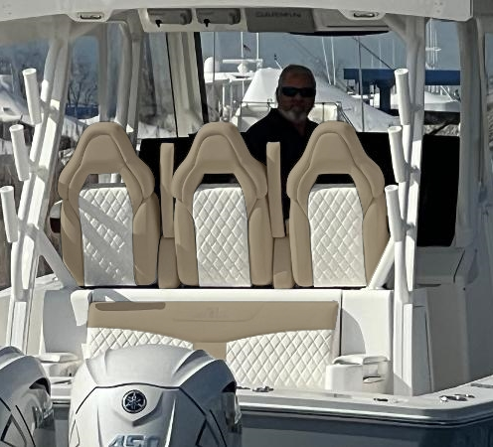
Upholstery
New exterior color SAND BAR with inlay texture

Slide 46
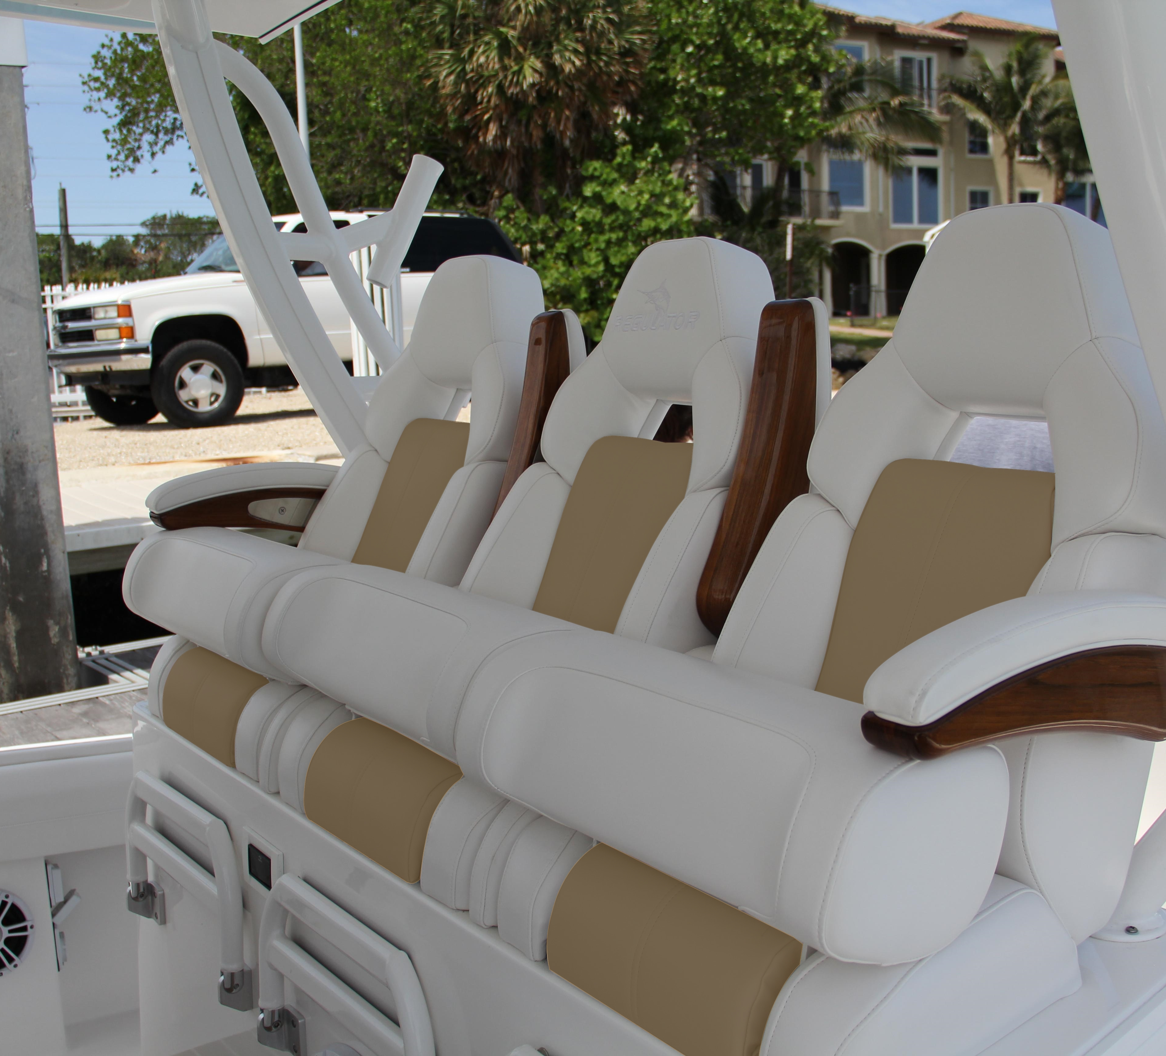
Upholstery
New exterior color SAND BAR with inlay texture

Slide 47
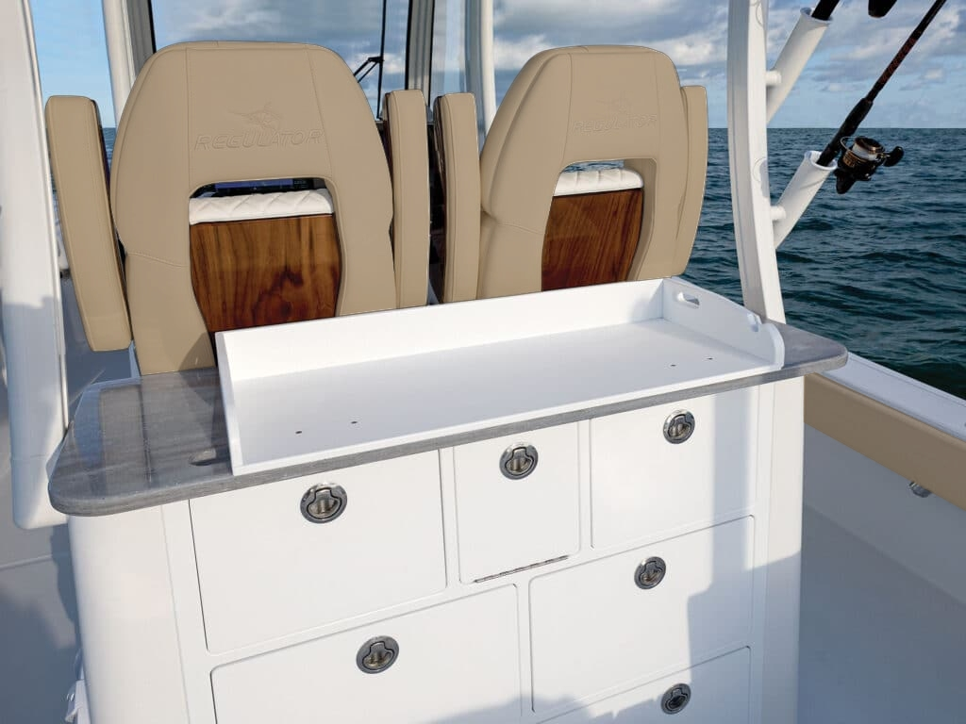
Upholstery
New exterior color SAND BAR with inlay texture

Slide 48
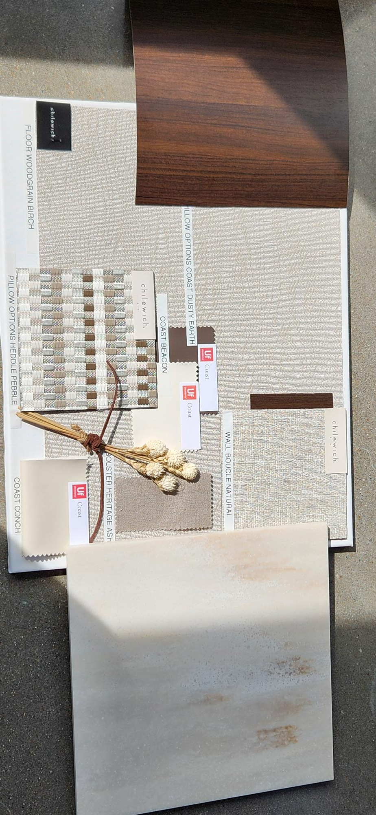
Upholstery
New exterior color SAND BAR with inlay texture
Optional interior color on 37 and 41
  Classic Luxe interior package with warm beige & deep brown tones
  Halcyon Luxe interior package with cool grey & warm white tones

Slide 49
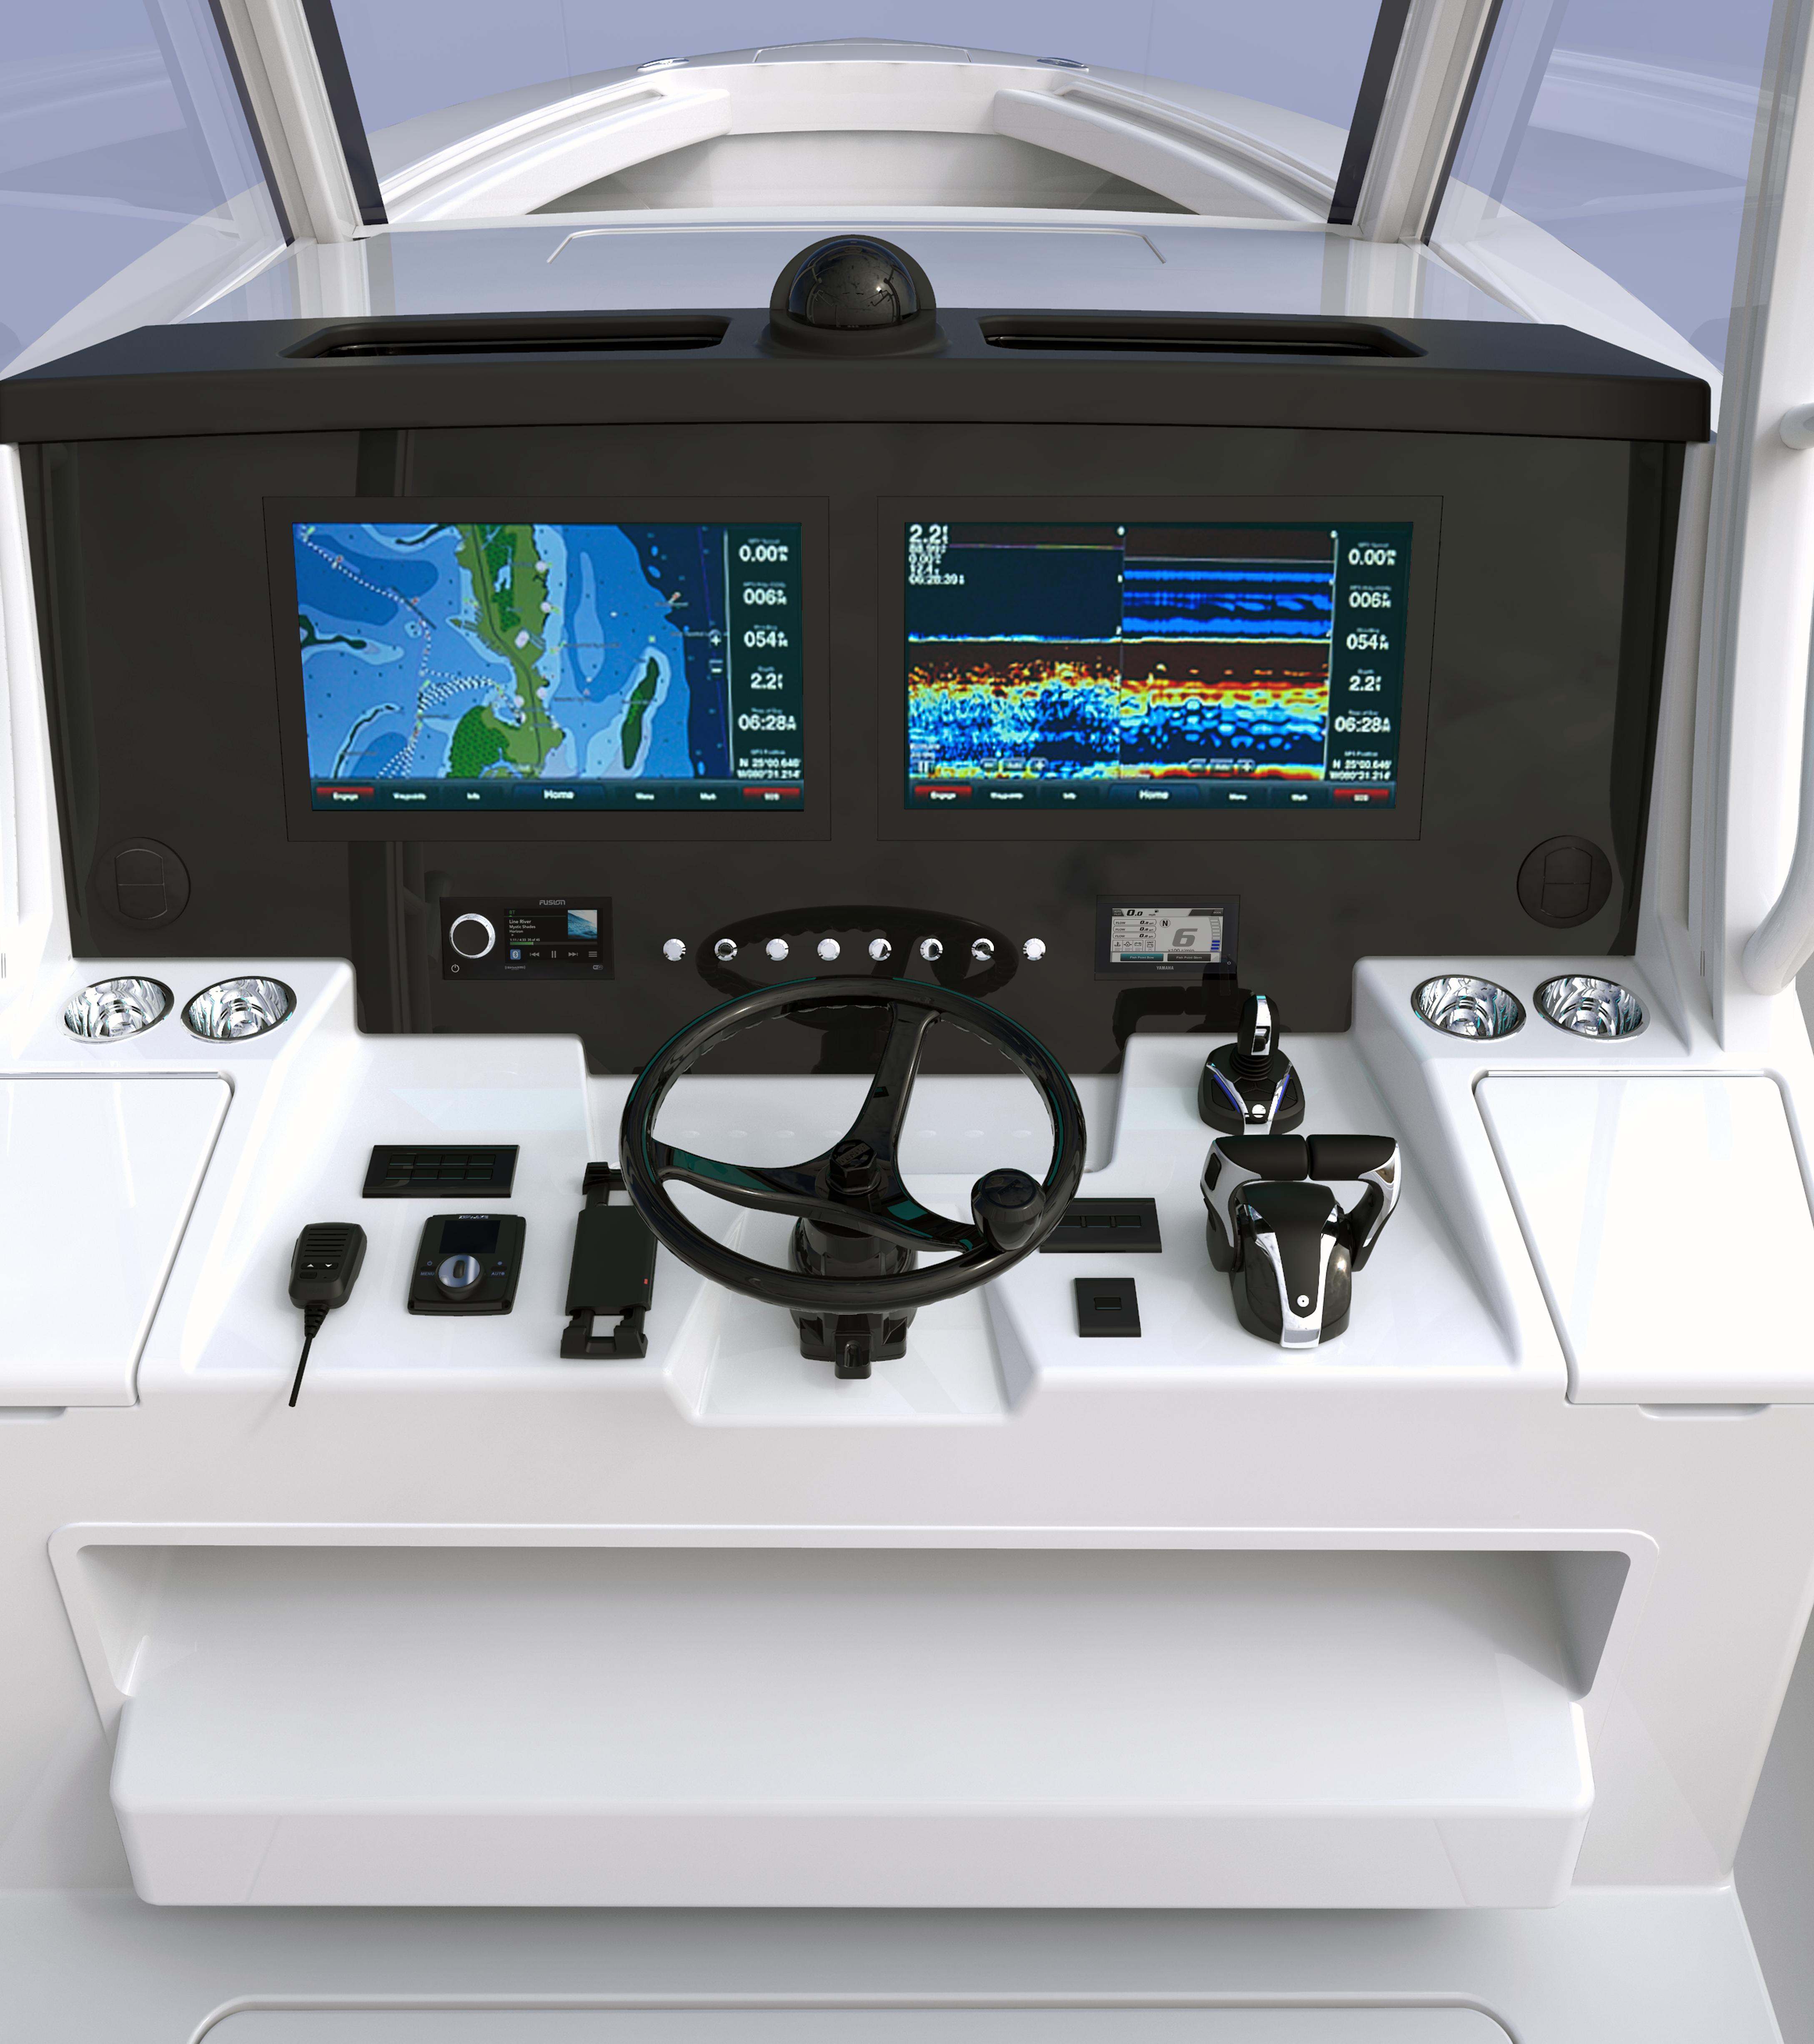
Helm updates
Cell chargers
  28 and up receive up to four chargers

Slide 50
Helm updates
Cell chargers
  28 and up receive up to four chargers
  Current charger at the helm remains

Slide 51
Helm updates
Cell chargers
  28 and up receive up to four chargers
  Current charger at the helm remains
  Add 1 clamp charger inside the console

Slide 52
Helm updates
Cell chargers
  28 and up receive up to four chargers
  Current charger at the helm remains
  clamp charger inside the console
  1 each inductive charger in each cubby

Slide 53
Helm updates
Cell chargers
  28 and up receive up to four chargers
  Current charger at the helm remains
  clamp charger inside the console
  1 each inductive charger in each cubby
  26xo opt: two cubby chargers

Slide 54
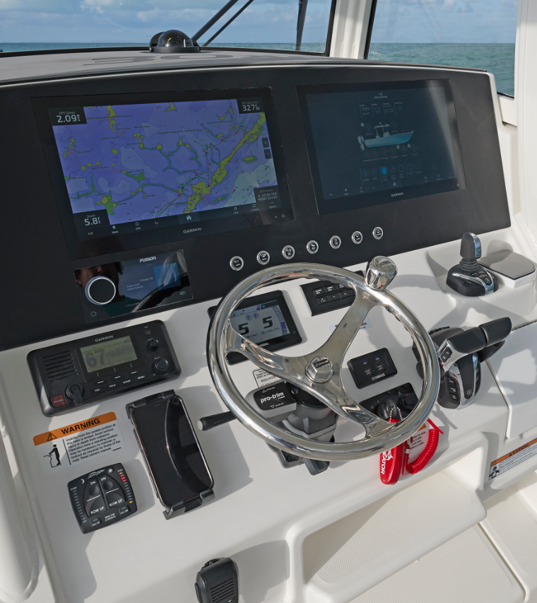
Helm updates
* Cell chargers and Tower note:
  Half tower option omits cubby chargers on 26 and 30xo
30xo – removed ProTap interface.
  Removed jack plate position sensors
  Will add power pole remotes to helm panel
  ProTap MyHelm screen will be removed

Slide 55
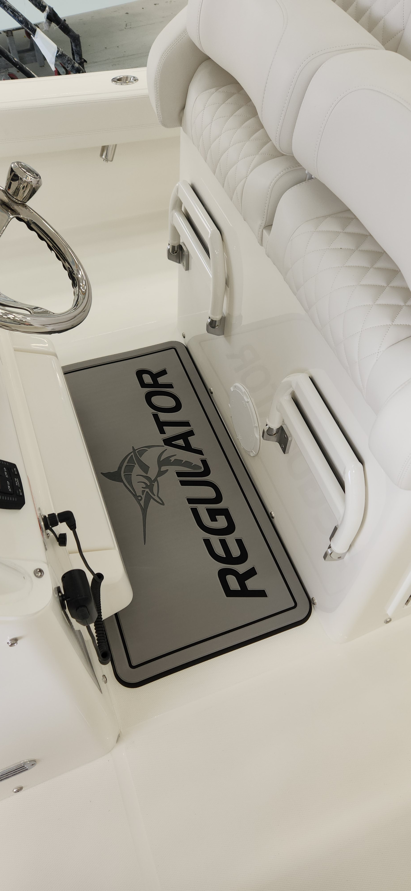
Life Aboard
Helm Mats
Factory installed option – all models

Slide 56
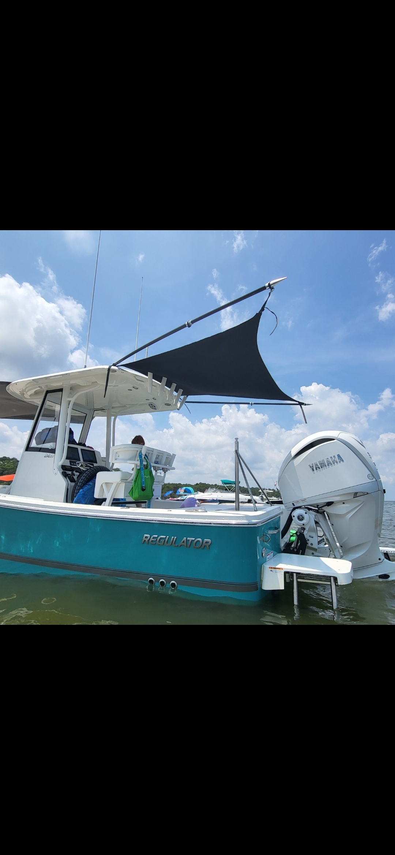
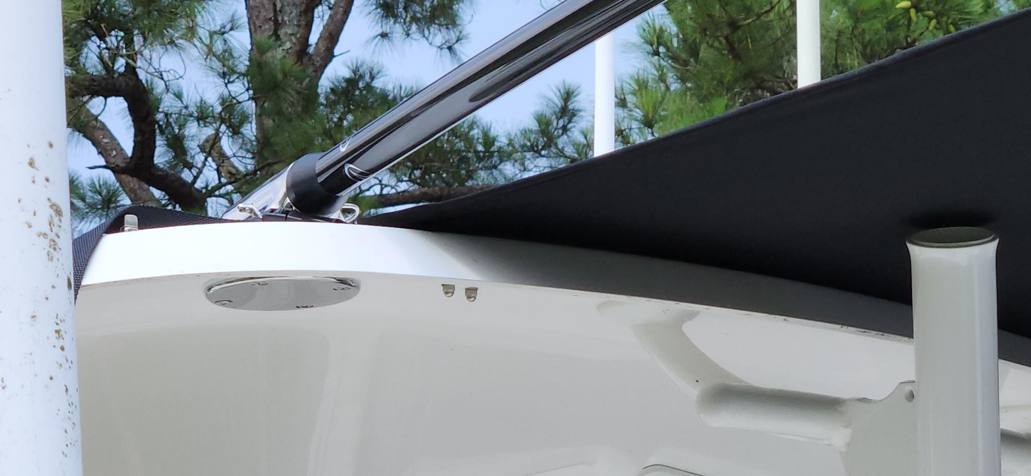
Life Aboard
XO rear shade
  Hardtop mounted bases with removable collapsible carbon poles and adjustable black shade

Slide 57
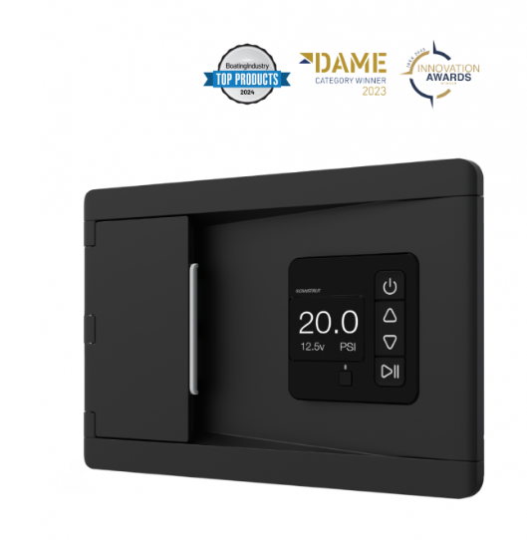
Life Aboard
Inflation Station
  Award-winning built-in DC air compressor
  Inflates and deflates
    Towable watersports toys ~ 3 minutes
    10ft SUP ~7 minutes @ 20 psi
    144 square foot inflatable platform ~15 minutes
  Available on the 26xo and up

Slide 58
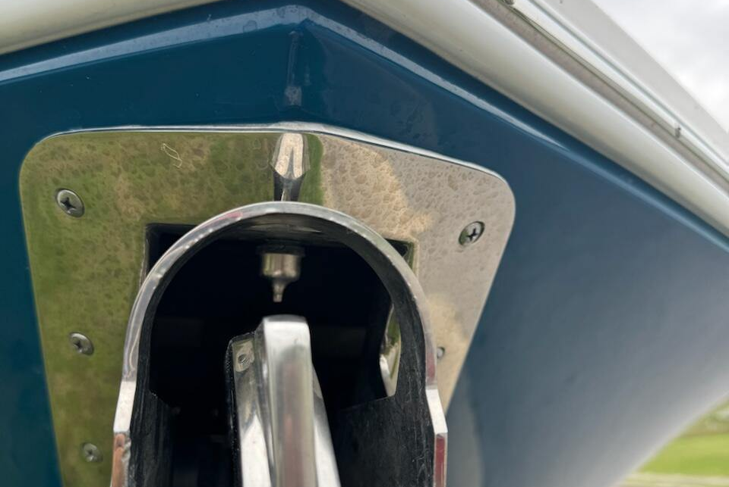
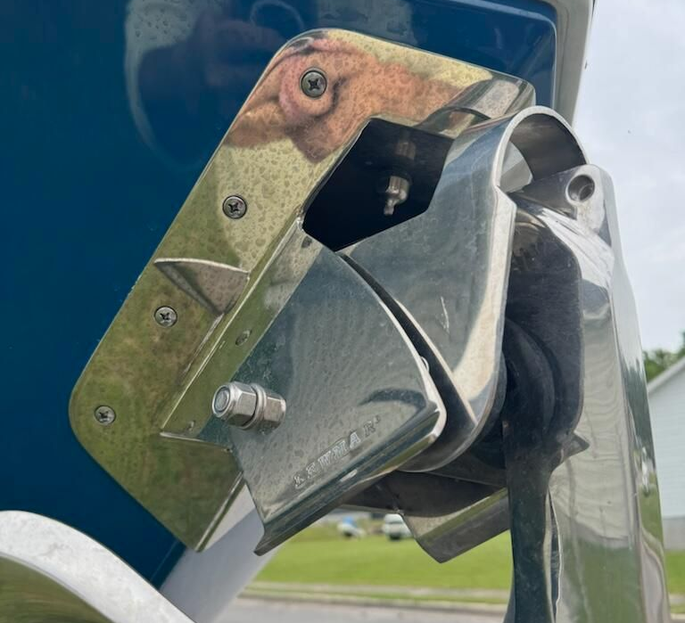
Life Aboard
Fresh water anchor wash
Washes the rode and chain as the anchor is retrieved automatically.
  Requires freshwater pump to be turned on.
  Manual valve under the deck if the owner wishes to disable.
  Standard on 37 and 41
  Will come as integrated part of windlass option on all other CC’s

Slide 59
2025 pricing

Slide 60
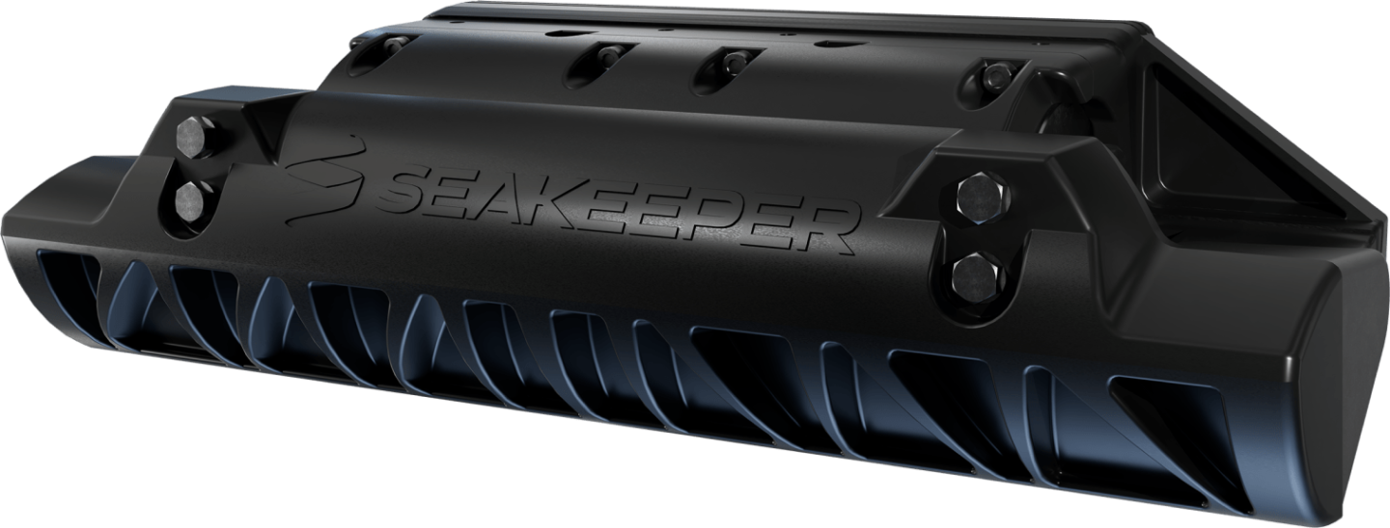
Sand Upholstery Same as the Dove Gray. Both stay at 2024 pricing
Rear shade XOs $2,995
Helm Mat-$395
Inflate station $1,795
Gyro 30XO $31,995
Seakeeper ride 24XO- $10,395
Seakeeper ride 26XO-$16,495
Phone Chargers X (2)-$595

Slide 61


Slide 62
28 went up $6,700 and got Seakeeper ride, upgraded Garmin interface, JL speakers, Fresh water washdown at windless, and choice of a few new options

Slide 63

28 went up $6,700 and got Seakeeper ride, upgraded Garmin interface, JL speakers, Fresh water washdown at windless, and choice of a few new options

Slide 64
28 went up $6,700 and got Seakeeper ride, upgraded Garmin interface, JL speakers, Fresh water washdown at windless, and choice of a few new options
34 went up $6,500 and got 350s, Seakeeper ride, upgraded Garmin interface, additional Siren monitoring, JL speakers, Fresh water washdown at windless, and choice of a few new options

Slide 65


Thank you

